Slide 1

Potholes and Humps Detection System in Real-Time
Project Final Phase Presentation on
Presented By | Under the Guidance of
Anusha M J 4PM20CS013 Bhoomika S P 4PM20CS023 Bindu K H 4PM20CS025 Inchara M M 4PM20CS043 | Mr. Shivanand C Maradi. Assistant professor, Dept. of CS&E. PESITM,Shimoga.

Slide 2
Contents
Abstract
Introduction
Existing System
Problem Statement
Literature Review
Objectives of the Project
Methodology
System Requirements Specification
System Design and Implementation
Results and discussion
Publication Details
Conclusion and future scope
References

Slide 3
Abstract
Potholes are formed due to wear and tear and weathering of roads. They cause not only discomfort to citizens but also deaths due to vehicle accidents.
Therefore to decrease this kind of accident we came up with a project which recognizes potholes on the roads using cameras and alerts the driver.
So the Machine learning algorithms are applied to recognize patterns in the data and make accurate predictions.
The proposed method involves sensors to collect data on road conditions, analyze the data and identify areas with humps.

Slide 4
Introduction
The project addresses the critical issues of road safety and vehicle maintenance by minimizing the risks associated with road hazards. The Indian government said total 4,775 and 3,564 accidents occurred in the years 2019 and 2020, respectively, due to potholes and 3.6 thousand accidents are occurred 2021.
The primary objective is to create a system that can accurately detect the presence of potholes and humps on roadways, and then transmit timely alerts to drivers.

Slide 5
The challenge at hand is to develop an advanced Pothole and Hump Detection System leveraging machine learning and image processing techniques, integrated with real-time alerting mechanisms for vehicles.
The system should operate effectively under varied light conditions and provide vehicles with alerts to enhance driver awareness and enable appropriate actions, ultimately improving road safety and reducing vehicle damage.

Slide 6
Existing System
Drone-Based Systems: Drones with high-resolution cameras and LIDAR sensors survey roads, with data processed to identify road defects.
GPS-Based Systems: GPS can be used to track the vehicle's position and speed. Changes speed or sudden deceleration can indicate the presence of speed humps or potholes.
Pothole Detection using Smartphone Sensors: Some systems leverage smartphone sensors like accelerometers and GPS to detect potholes. These systems use the accelerometer data to detect sudden drops (indicative of a pothole) and GPS data to mark the pothole's location.

Slide 7
Disadvantages of the existing System
Drone-based systems are limited by the range and flight time of the drones. This can restrict the area that can be surveyed in a single flight, requiring multiple flights to cover larger areas.
Not all smartphones may have the necessary sensors or capabilities required for accurate pothole detection. This can limit the reach and effectiveness of the system, especially in regions where smartphones with advanced sensors are less common.
GPS-based systems rely on a network of satellites and ground stations, which may not be available or reliable in all locations. This can limit the effectiveness of the system in remote or rural areas.

Slide 8
Proposed System
Combining computer vision and sensors, this system detects potholes and humps in real-time. A camera and YOLO software analyze video for potholes, while an ultrasonic sensor and Arduino Uno mounted on the vehicle identify humps. Auditory alerts like a buzzer warn drivers of these hazards, promoting road safety and preventing vehicle damage.

Slide 9
Problem Statement
“The challenge is to create a Pothole and Hump Detection System capable of identifying road imperfections, such as potholes and humps, and providing real- time alerts to two wheeler riders”.

Slide 10
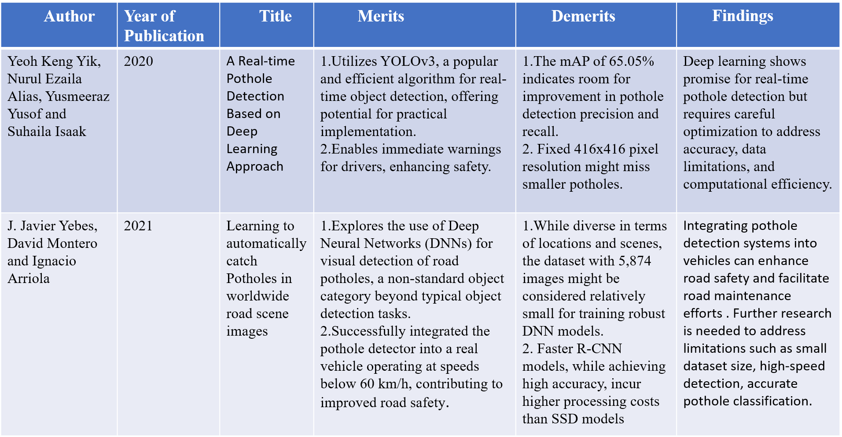
Literature Review

Slide 11
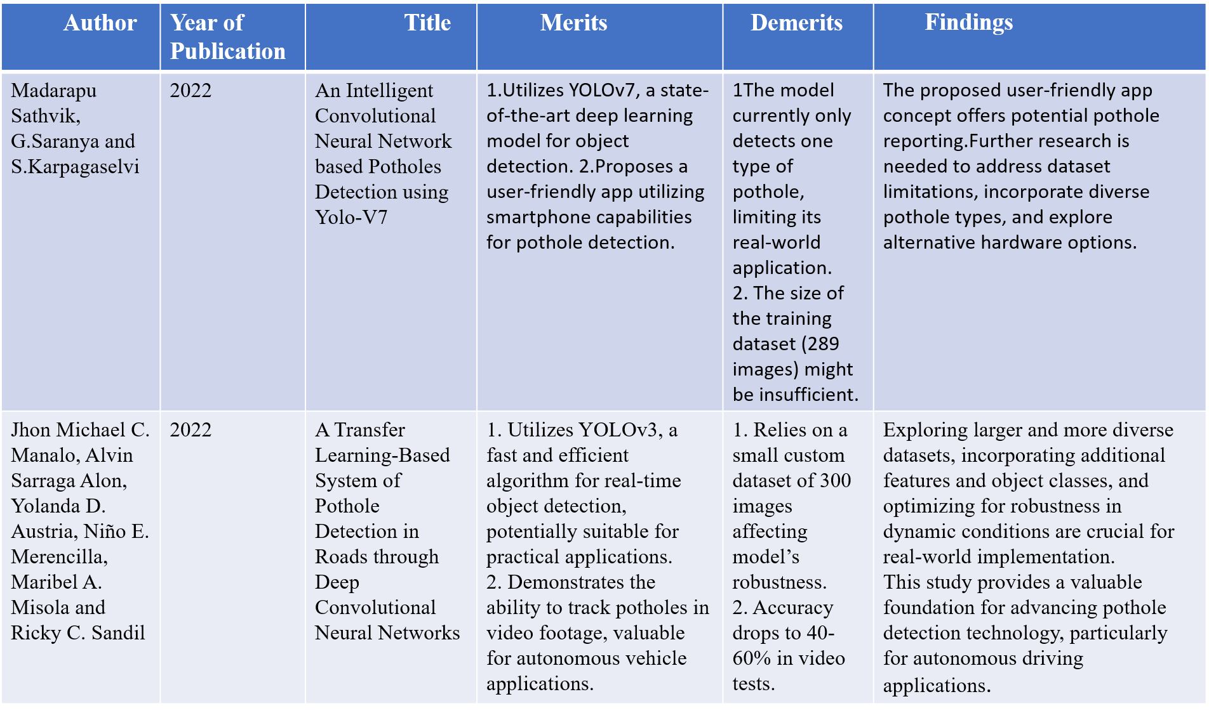

Slide 12
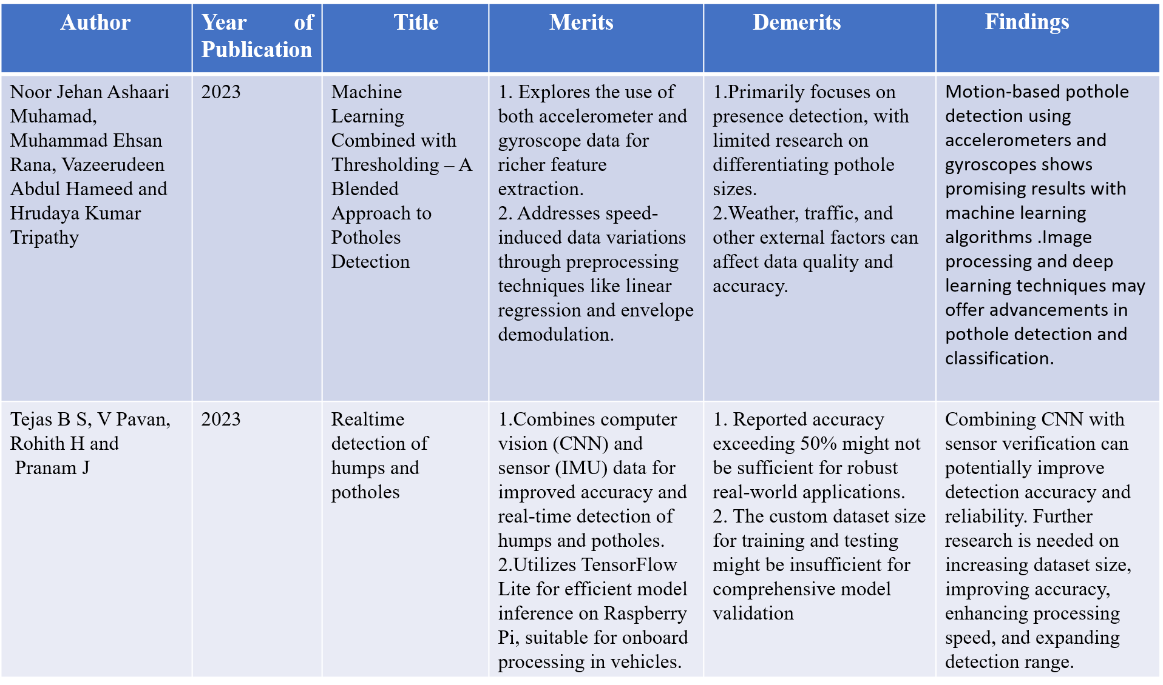

Slide 13
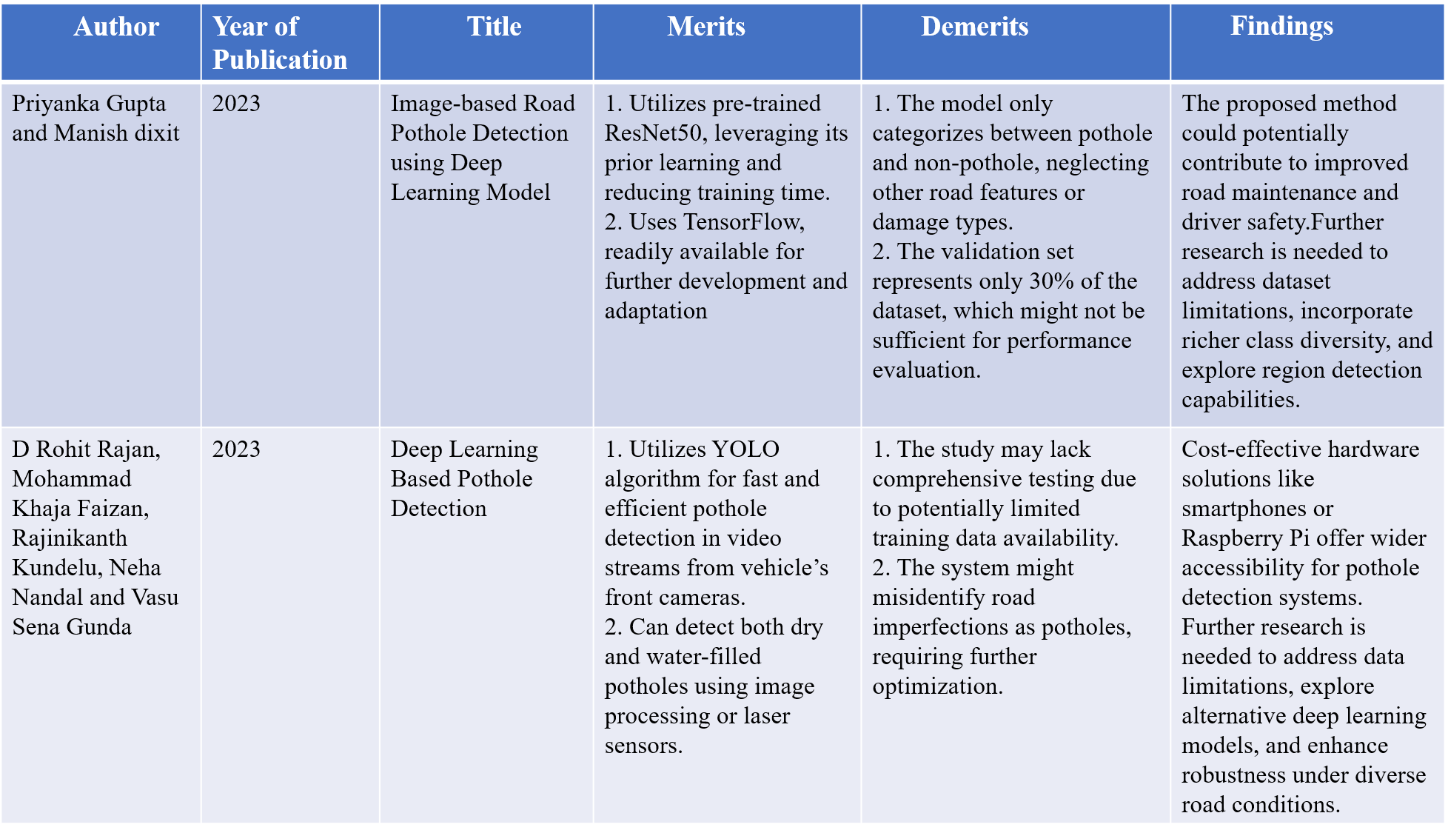

Slide 14
Author | Year of Publication | Title | Merits | Demerits | Findings
Fuzeng Zhang, Askar Hamdulla, | 2022 | Research on Pothole Detection Method for Intelligent Driving Vehicle | 1.Provides a detailed overview of various pothole detection methods, including vision-based, vibration-based, 3D reconstruction-based, and deep learning approaches. 2. Emphasizes the importance of pothole detection for assisted and autonomous driving safety | 1. The review mentions several deep learning models but lacks a detailed evaluation of their performance and limitations. 2.concrete future research directions could be further elaborated on. | Addressing data limitations, improving detection accuracy, and mitigating external factor influences are crucial for robust and reliable pothole detection systems. Further research should focus on model optimization, sensor fusion, and real-time implementation for practical applications.
Abhishek Kumar, Chakrapani, Dhruba Jyoti Kalita and Vibhav Prakash Singh | 2023 | A Modern Pothole Detection technique using Deep Learning | 1.Utilizes Faster R-CNN Inception-V2, a powerful deep learning architecture for object detection. 2.Further reduces computational cost without sacrificing accuracy. | 1.Requires integration with video cameras, which might not be suitable for all vehicles or environments. 2.Deep learning models may misidentify objects, potentially leading to unnecessary warnings. | The proposed deep learning-based model utilizes Transfer Learning, Faster R- CNN, and Inception-V2 to detect potholes in Indian roads, addressing the challenge of poor construction quality. The system outperforms existing techniques, aiming to reduce accidents and enhance road safety.

Slide 15
Summary of the literature survey
The project represents a significant advancement in pothole detection methods, addressing key limitations identified in previous approaches. It prioritizes computational efficiency through the utilization of the YOLOv4-Tiny model, enabling deployment on diverse hardware while overcoming the processing power demands of models like Faster R-CNN. Moreover, the project implements strategies to minimize false positives and addresses privacy concerns, further enhancing the practicality and reliability of the pothole detection system.

Slide 16
Objectives
To collect pothole images, label and annotate it.
To train, test and detect the pothole on road.
To design and develop an alert system for two-wheeler drivers when a hump or pothole is detected.
To store the pothole detected output video file in the result folder which will be useful for municipal corporation department and smart city projects for road maintenance.

Slide 17
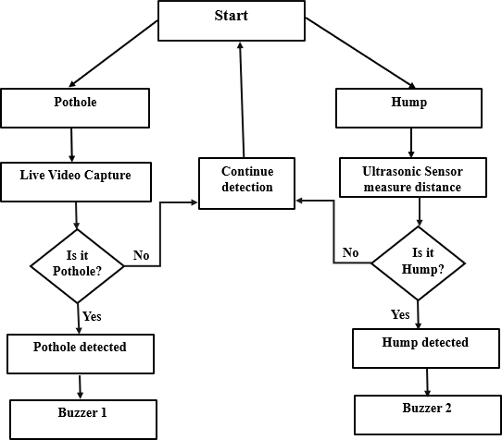
Methodology
Figure 1: Flow chart

Slide 18
Procedure:
Data Collection: The project will involve collecting a large dataset of road images containing potholes. This dataset will be crucial for training the YOLOv4-Tiny model to effectively recognize these road imperfections.
Data Annotation: Each image in the dataset will be meticulously annotated with bounding boxes around the potholes. This annotation process tells the YOLOv4-Tiny model what features to look for when identifying these objects in future images.

Slide 19
YOLOv4-Tiny Model Training: The annotated dataset will be used to train the YOLOv4- Tiny model. During training, the model will learn to recognize the patterns and features that distinguish potholes from other road elements.
Real-Time Detection: Once trained, the YOLOv4-Tiny model will be integrated into a real-time system. A camera mounted on a vehicle or infrastructure will capture live video footage of the road. Each frame of the video will be fed into the YOLOv4-Tiny model, which will then analyze the image and identify any potholes or humps present.

Slide 20
Output and Applications: The system will output real-time information about the detected potholes. This information could include timestamps and accuracy of detection. This data can be used for smart city projects and municipal corporation.

Slide 21
System Requirements Specification
Hardware Requirements:
Webcam
HC-SR04 Ultrasonic Sensor: Sensor measuring distance using sound waves, essential for detecting road humps without physical contact.
Buzzer: Audio signaling device emitting beeps for real-time alerts upon hump detection.
Arduino UNO: Microcontroller board with ATmega328P, 14 digital I/O pins, 6 analog inputs, used for interfacing sensors and controlling buzzer alerts.

Slide 22
Software Requirements:
Programming Languages:
Python
C++
Arduino IDE: Primary development environment for programming and uploading code to the Arduino UNO, facilitating sensor interfacing and control structures.

Slide 23
YOLOv4 Tiny Model
Step 1: Residual Blocks
Grid Division: The input image is divided into a grid of S x S cells.
Object Detection: Each grid cell is responsible for detecting objects whose center falls within it.
Step 2: Bounding Box Regression
Attributes: Each bounding box has a width (b_{w}), height (b_{h}), class (c), and center (b_{x}, b_{y}).
Prediction: YOLO uses regression to predict these attributes along with the confidence score for each bounding box.

Slide 24
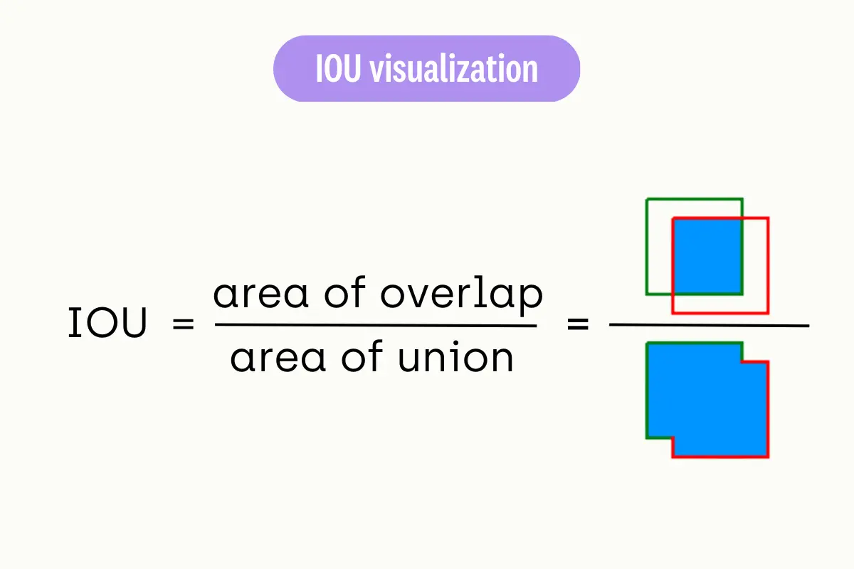
Step 3: Intersection Over Union (IOU)
IOU Calculation: Measures overlap between predicted and actual bounding boxes.
Optimization: YOLO maximizes IOU to refine predictions, ensuring accurate bounding box placement.

Slide 25
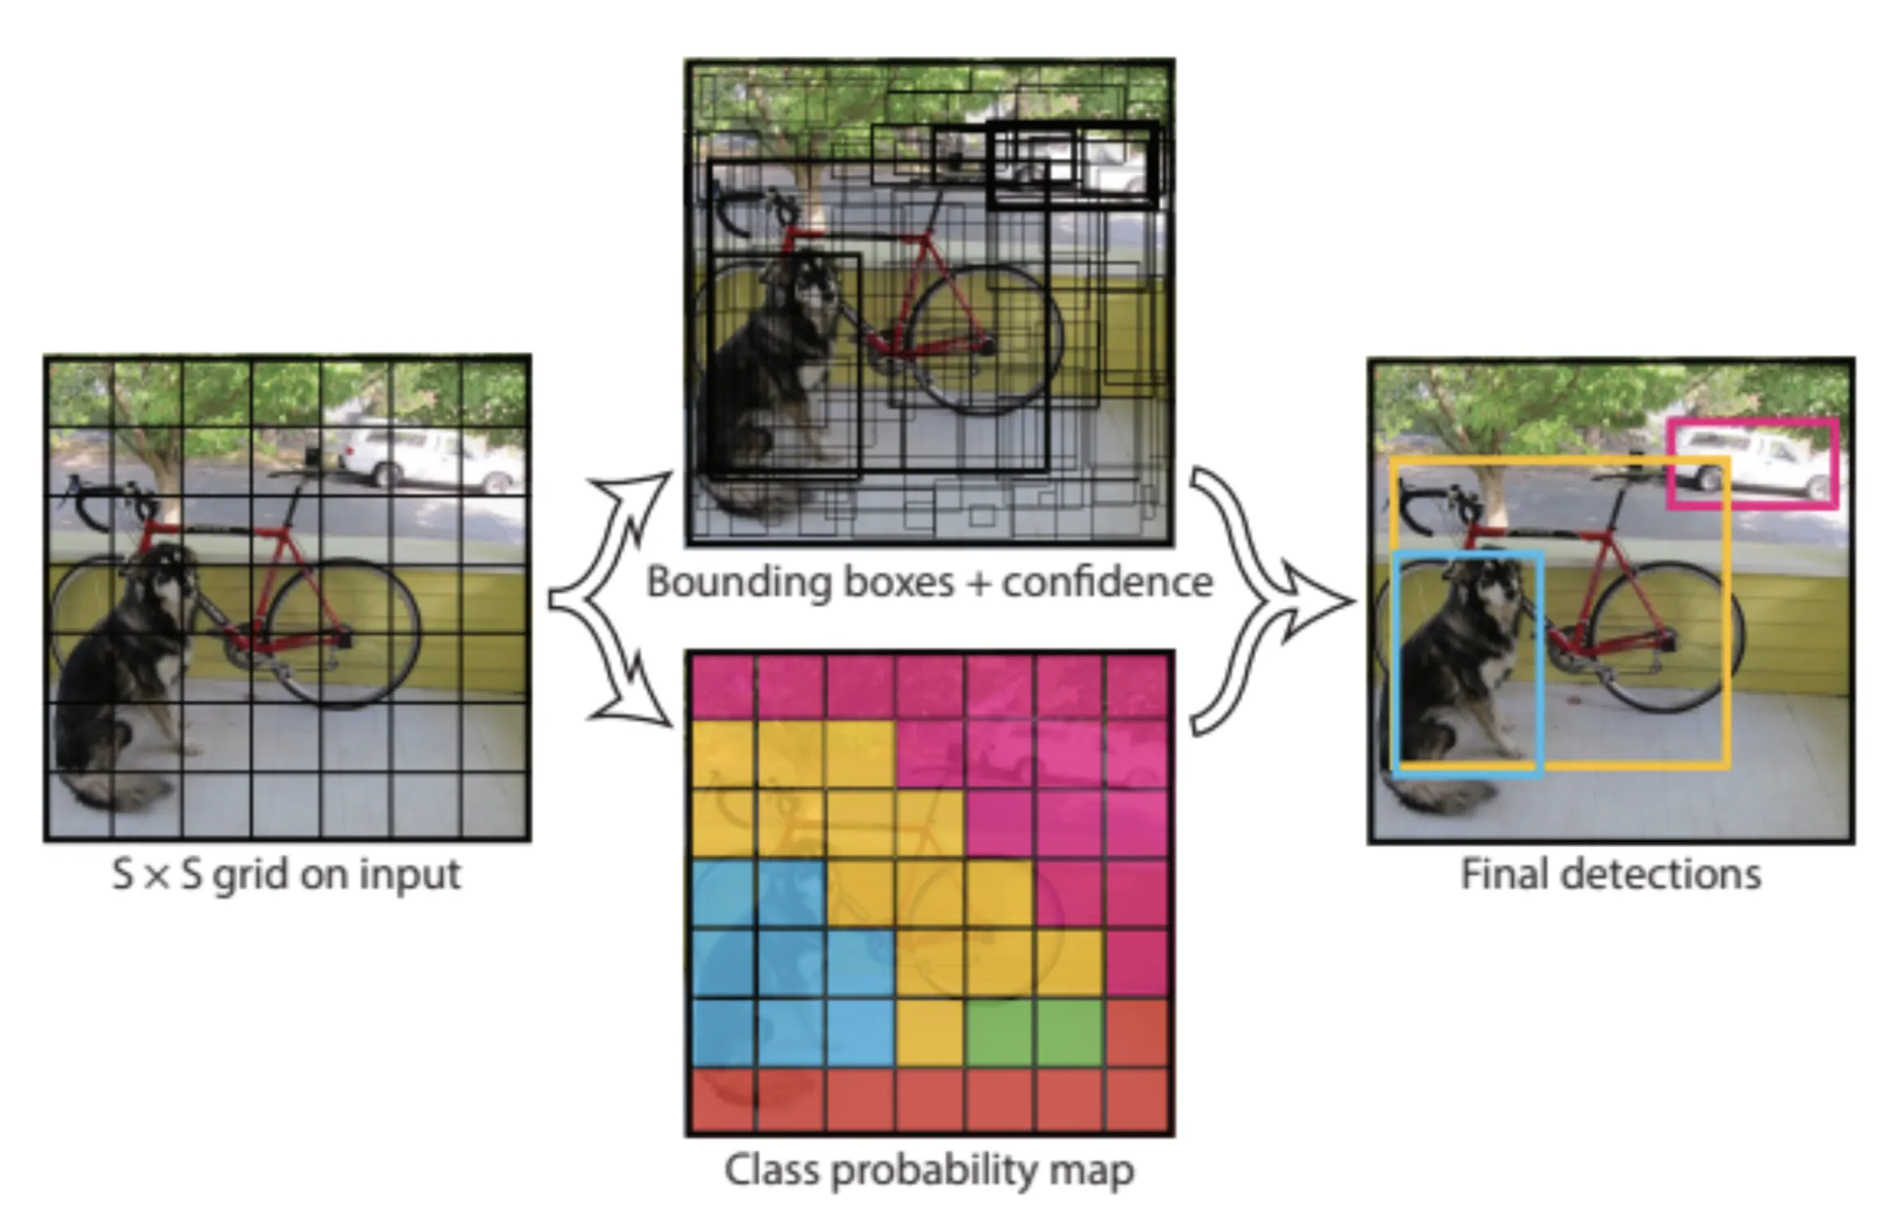
Figure 2: YOLOv4 working steps The image shows how the YOLOv4 steps are applied to produce the final detection results.

Slide 26
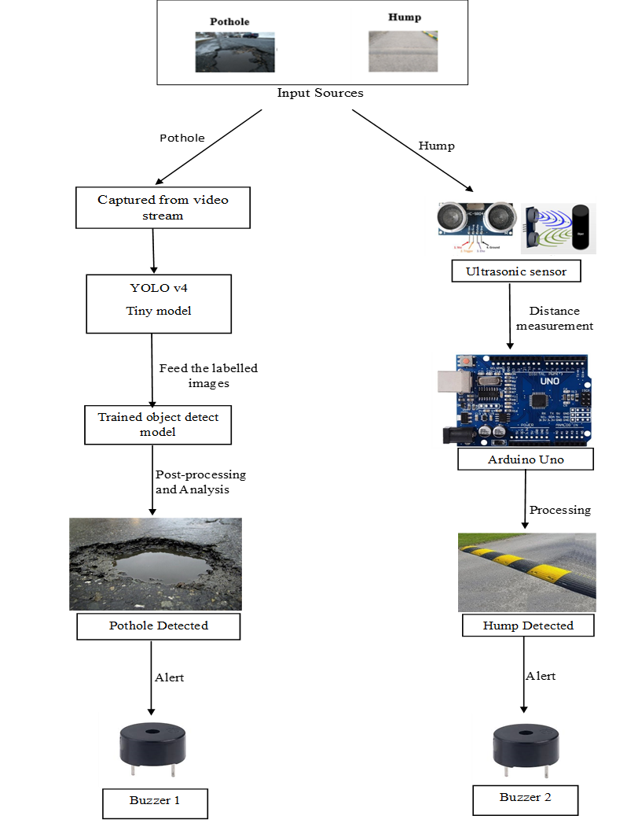
System Design
Figure 3: System Architecture

Slide 27
Pothole
Input Source: The system captures a video stream as the input source.
Labelled Images: The YOLOv4 tiny model was trained on a dataset of labelled images containing potholes. During training, the model learned to recognize the features of potholes in images.
YOLOv4 Tiny Model: The video stream is fed into a pre-trained convolutional neural network model called YOLOv4 tiny model. This model is designed to identify potholes in images.

Slide 28
Object Detection: When the YOLOv4 tiny model processes a frame from the video stream, it outputs a bounding box around any potholes it detects in the frame.
Post-processing and Analysis: Check the size and shape of the bounding box around the pothole. Consider a confidence score from the model to see how certain it is about the pothole. Analyze detections across multiple video frames for consistency.
Buzzer 1: The buzzer is an alerting device that emits a sound when a pothole is detected.

Slide 29
Hump
Ultrasonic sensor: The ultrasonic sensor emits 40Hz waves and waits for their return. When a wave hits an object, it bounces back and is detected by the receiver. By measuring this time, the sensor calculates distance accurately.
Distance measurement: The Arduino Uno receives the signal from the ultrasonic sensor and uses it to calculate the distance of the object.
Hump detected: If the distance measurement is below a certain preset threshold value, it indicates that a hump has been detected.
Buzzer 2:When a hump is detected, the Arduino Uno will activate an alert.

Slide 30
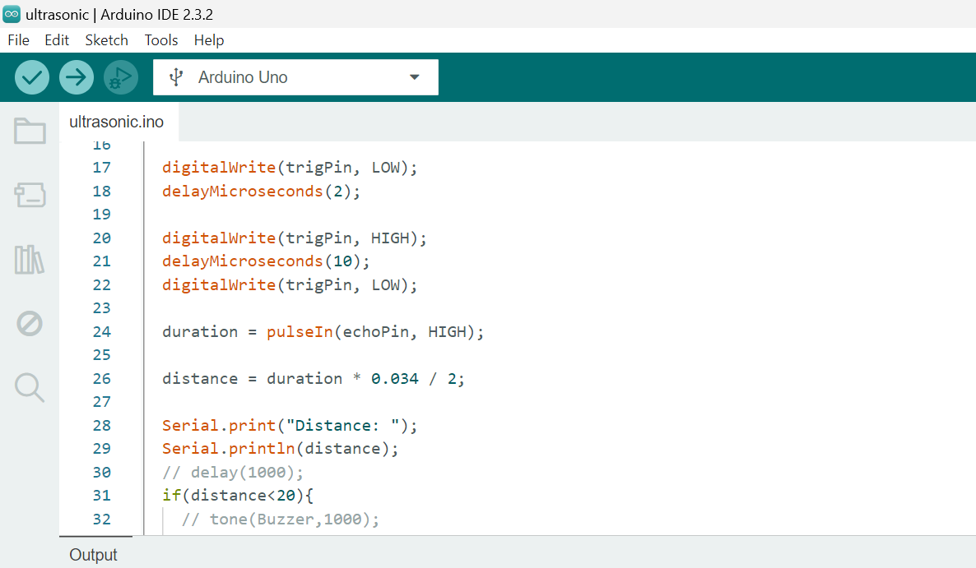
System Implementation
Code snippet: Measuring Distance
This section includes the process of sending an ultrasonic pulse and measuring the duration it takes for the pulse to return.

Slide 31
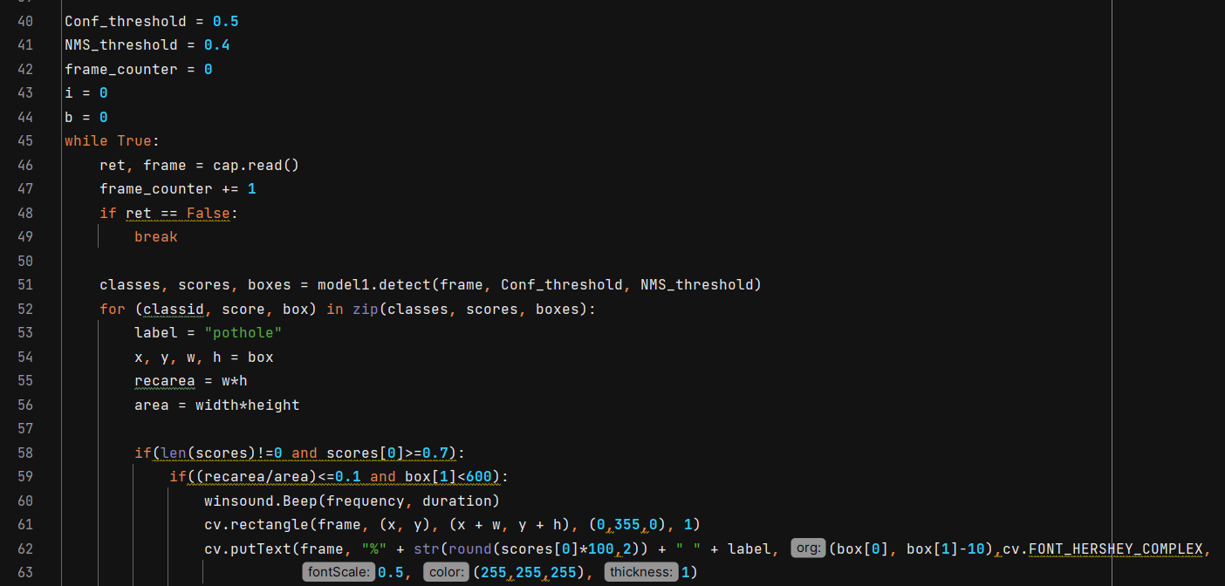
Code snippet: Detecting Potholes
This part processes each frame, detects potholes, and triggers an alert when a pothole is found.

Slide 32
Result and discussion
Test Scenario | Condition | Detection Accuracy
Scenario 1 | Pothole | 85-90%
Scenario 2 | Water filled Pothole | 80-90%
Scenario 3 | Potholes during night time | 70-75%
Table 1: Pothole detection accuracy under different conditions
The table shows the detection accuracy of a pothole detection system under different test scenarios. The scenarios include potholes on dry surfaces, water filled potholes, and potholes at night. The system performs best in well-lit conditions, with an accuracy of 85-90% for detecting potholes on dry surfaces. The accuracy drops to 80-90% when detecting water filled potholes, and to 70-75% for potholes at night.

Slide 33
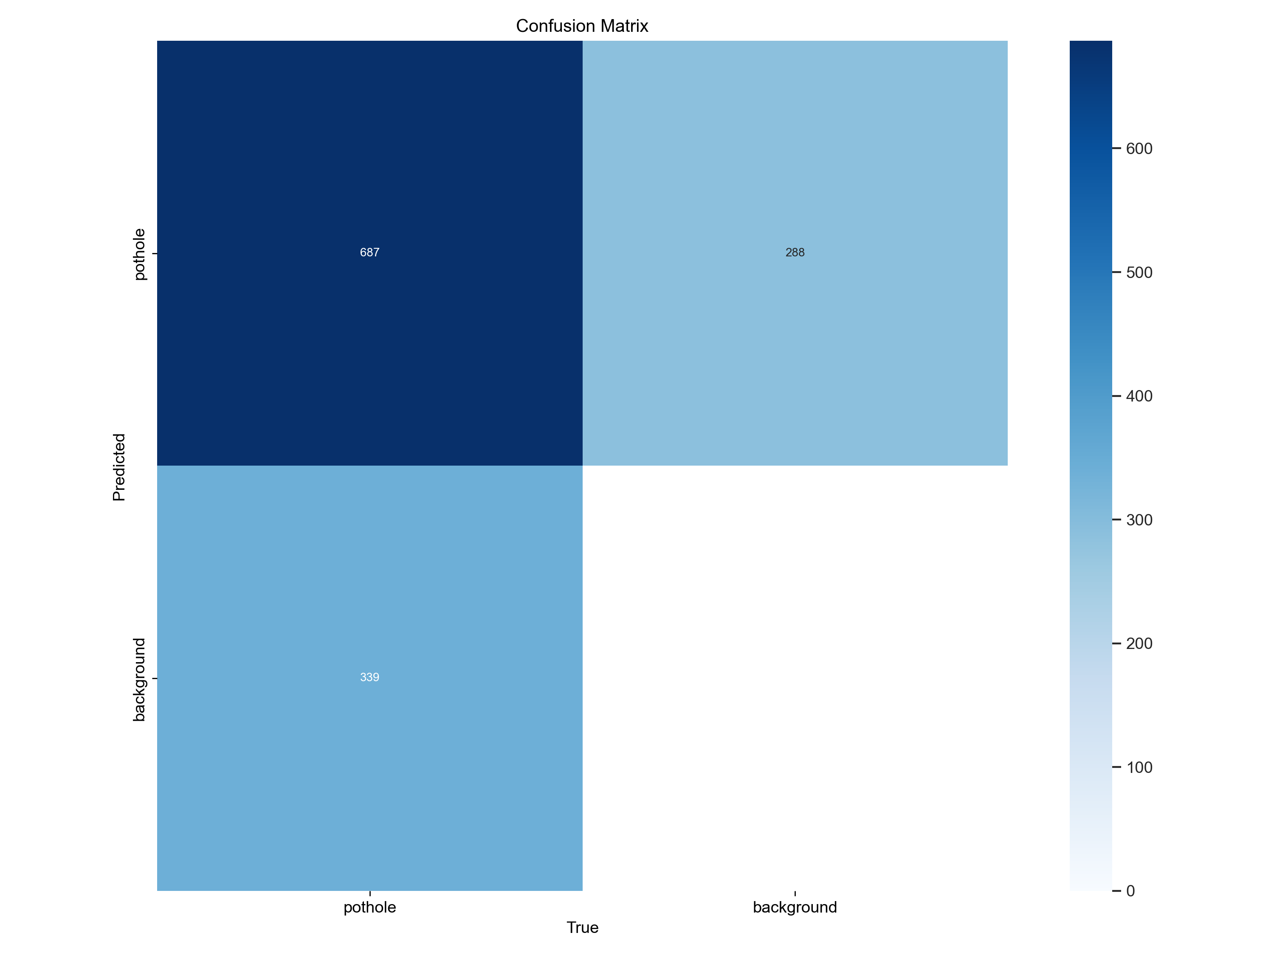
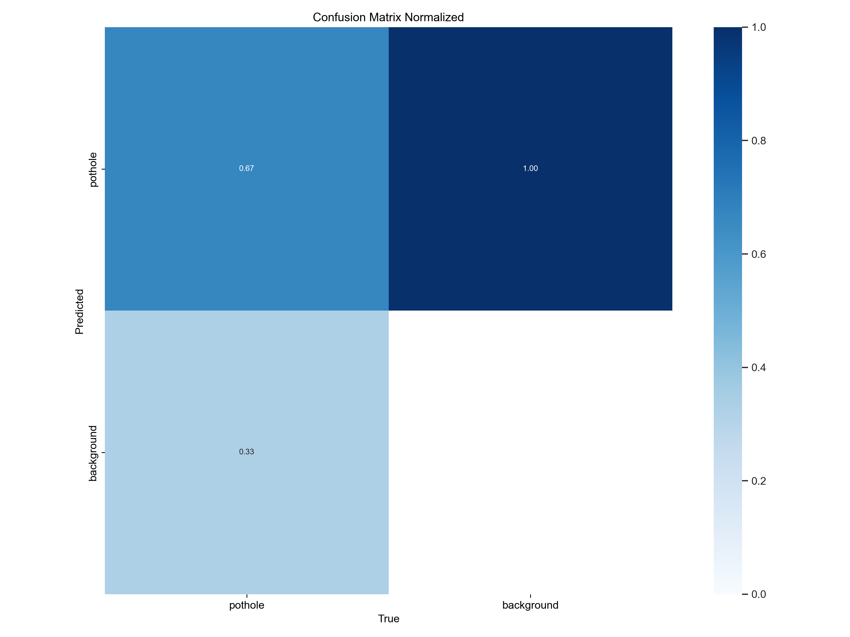
Confusion Matrix
Confusion Matrix Normalized

Slide 34
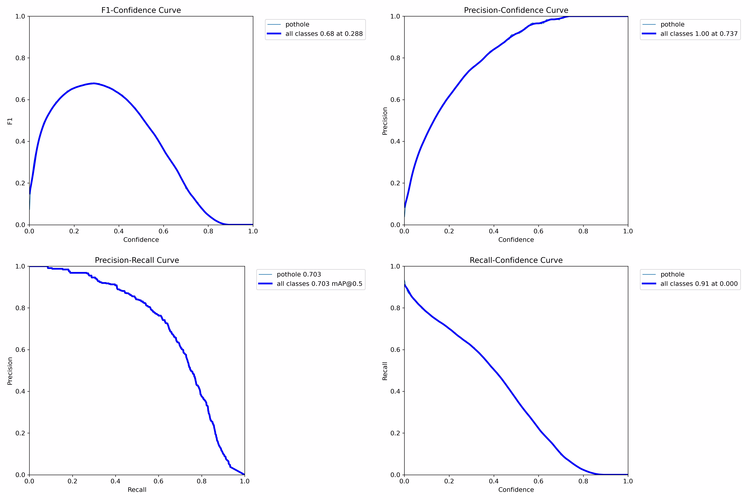
Performance Evaluation of Pothole Detection Model

Slide 35
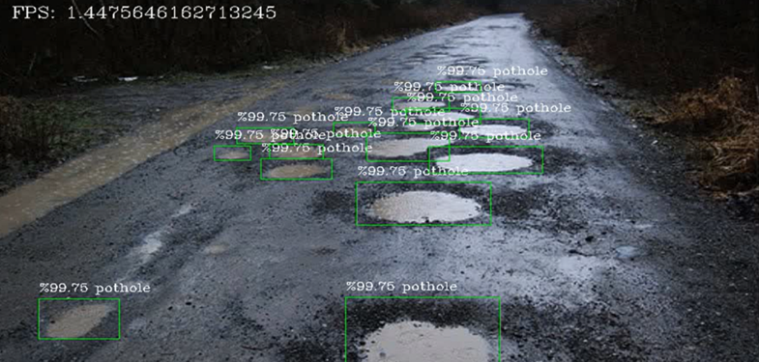
Snapshots
Figure 4: Water filled potholes detected
This indicates that the pothole detection model has successfully identified water-filled potholes in the image with a high accuracy of 92.2%.

Slide 36
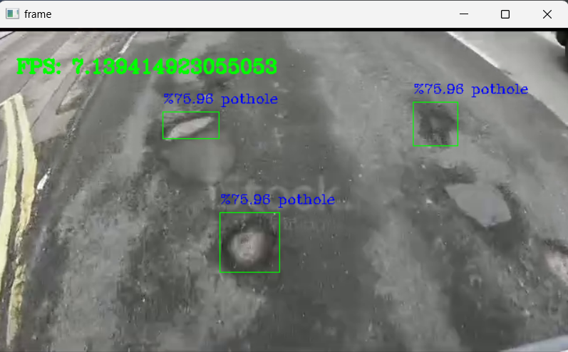
Figure 5: Potholes detected
The system makes use of the YOLOv4 Tiny model's pothole detection capabilities in. real-time.

Slide 37
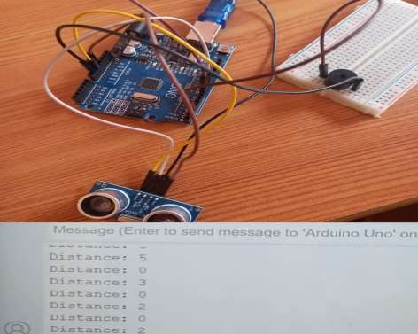
Figure 6: Prototype for hump detection
This demonstrates the feasibility of using an ultrasonic sensor to detect the presence of a hump.

Slide 38
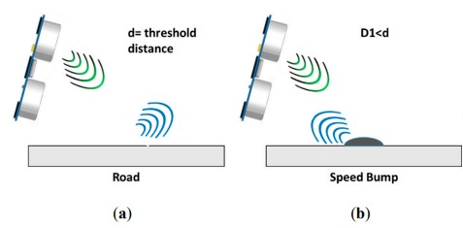
Figure 7: Working of ultrasonic sensor, (a)Plain Road, (b) Speed bump
The picture shows how a sensor can be used to detect bumps on a road. The Waves from the Ultrasonic sensor hitting the flat surface and reflecting back in fig 4a, and hitting speed bump and reflecting back in fig 4b.

Slide 39
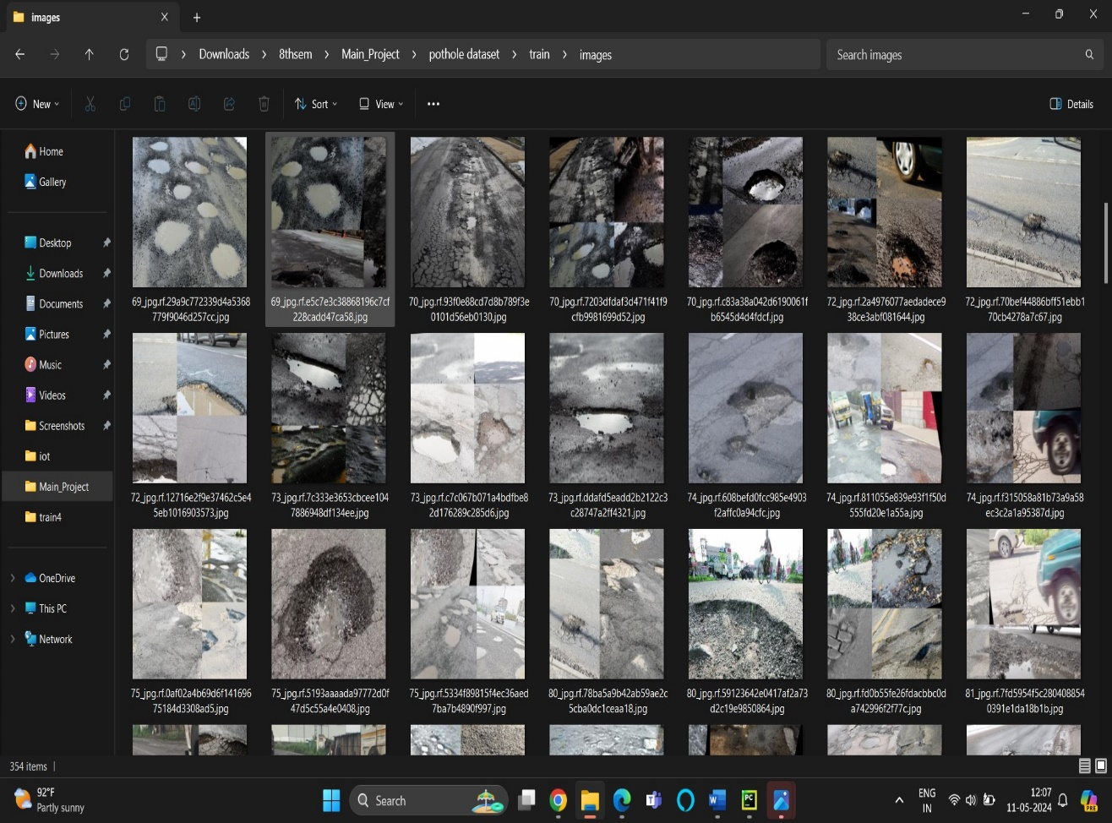
Objective 1: Collection, Labeling, and Annotation of Pothole Images
Figure 8: Data collection images for potholes
This picture shows an image of data collection done for potholes. The data collected from various means which includes manual collection, roboflow and online sources. There is total of 1700 images collected in all.

Slide 40
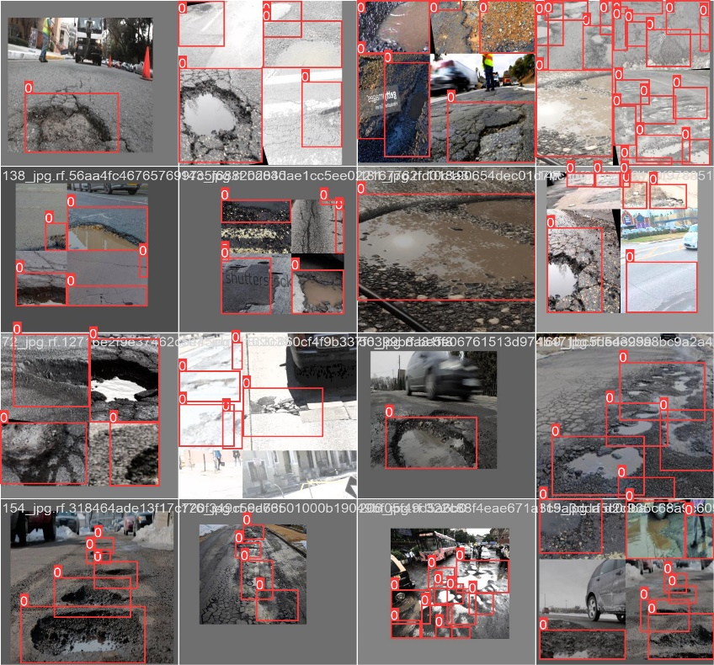
Objective 2: Training, Testing, and Detection of Potholes on Road
Figure 9: Trained batch of pothole images
The training phase commenced with the preparation of the annotated dataset, which was split into training and testing sets to ensure unbiased evaluation. Utilizing the YOLOv4 Tiny model architecture, the training process involved fine-tuning the pre-trained model on the annotated dataset to optimize pothole detection performance.

Slide 41
Objective 3: Design and Development of Alert System for Two-Wheeler Drivers
The objective of designing and implementing an alert system for two-wheeler drivers upon detecting humps or potholes was achieved by integrating ultrasonic sensors for hump detection and the YOLOv4 Tiny model for pothole detection. Upon detecting a hump or pothole, the system triggers a buzzer to emit an audible alert, ensuring timely notification to drivers.

Slide 42

Objective 4: Storage of Pothole Detected Output Video Files
Figure 10: The output video files stored in a results folder
To achieve this objective, output video files containing detected potholes were systematically stored in a designated result folder using file management techniques in Python.

Slide 43
Publication details
we have published the "Potholes and Humps Detection System In Real Time" project related paper in the International Journal Of Advanced Research In Science Communication and Technology [IJARSCT], in the year 2024 April with DOI: 10.48175/IJARSCT-17682

Slide 44




Publication details
Publication details

Slide 45
Conclusion
The project Integrates YOLOv4-Tiny Model, ultrasonic sensors, Arduino, and a webcam to detect the presence of potholes and humps on the road surface. YOLOv4-Tiny identifies potholes, while ultrasonic sensors detect road humps, ensuring comprehensive road surface analysis. The real-time detection capability enables timely alerts to two-wheeler riders, enhancing road safety, reduces the risk of accidents and also saves a potential life.

Slide 46
Future scope
Develop advanced image processing algorithms capable of simultaneously detecting both humps and potholes within a single frame.
Utilize GPS Road data to optimize routes, offering drivers alternative paths to avoid potholes or humps through navigation systems, thereby enhancing safety and efficiency.
Implement an adaptive alerting system that adjusts alert frequency based on vehicle speed, road conditions, and hazard proximity for context-aware warnings to drivers.

Slide 47
References
[1] Yeoh Keng Yik, Nurul Ezaila Alias, Yusmeeraz Yusof and Suhaila Isaak.(2020).” A Real-time Pothole Detection Based on Deep Learning Approach”.2020 IEEE International Conference.
[2] J. Javier Yebes , David Montero and Ignacio Arriola.(2021).“ Learning to automatically catch Potholes in worldwide road scene images. Published in 2021 IEEE International Conference on Cloud Computing in Emerging Markets (CCEM).”
[3] Jhon Michael C. Manalo, Alvin Sarraga Alon, Yolanda D. Austria, Nino E.Merencilla , Maribel A.Misola , Ricky C. Sandi.(2022).“ A Transfer Learning-Based System of Pothole Detection in Roads through Deep Convolutional Neural Networks”. Published in 2022 IEEE International Conference .

Slide 48
[4] Madarapu Sathvik, G.Saranya , S.Karpagaselvi. “An Intelligent Convolutional Neural Network based Potholes Detection using Yolo-V7”(2022). Published in 2022 IEEE International Conference on Automation.
[5] Fuzeng Zhang, Askar Hamdulla.“Research on Pothole Detection Method for Intelligent Driving Vehicle”.2022 3rd International Conference on Pattern Recognition and Machine Learning (PRML) .
[6] Abhishek Kumar, Chakrapani, Dhruba Jyoti Kalita, Vibhav Prakash Singh.“A Modern Pothole Detection technique using Deep Learning”(2023).

Slide 49
THANK YOU

